Slide 1
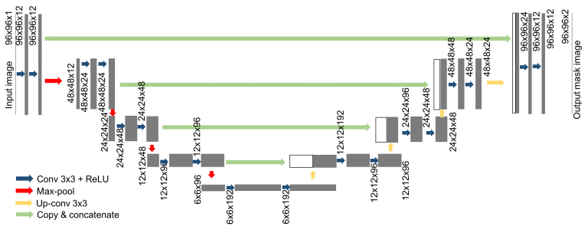
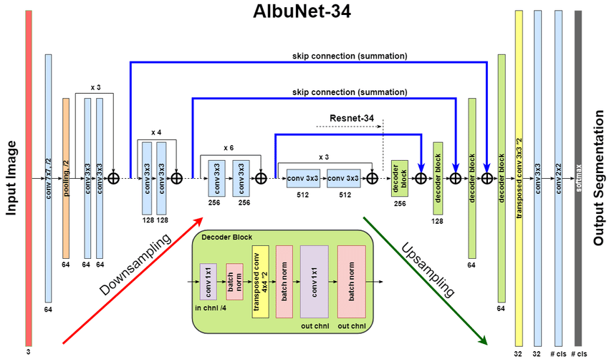
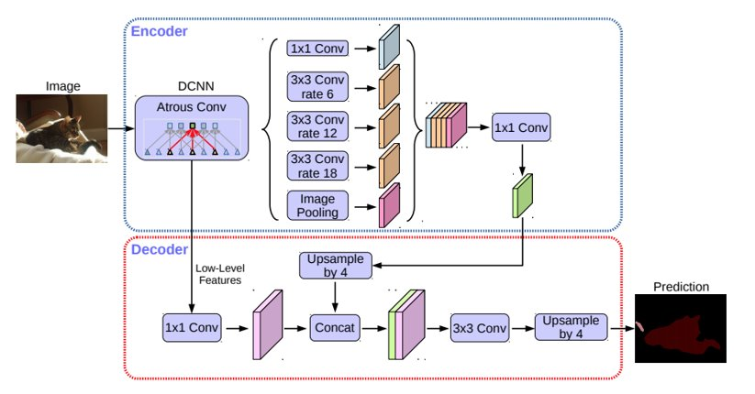
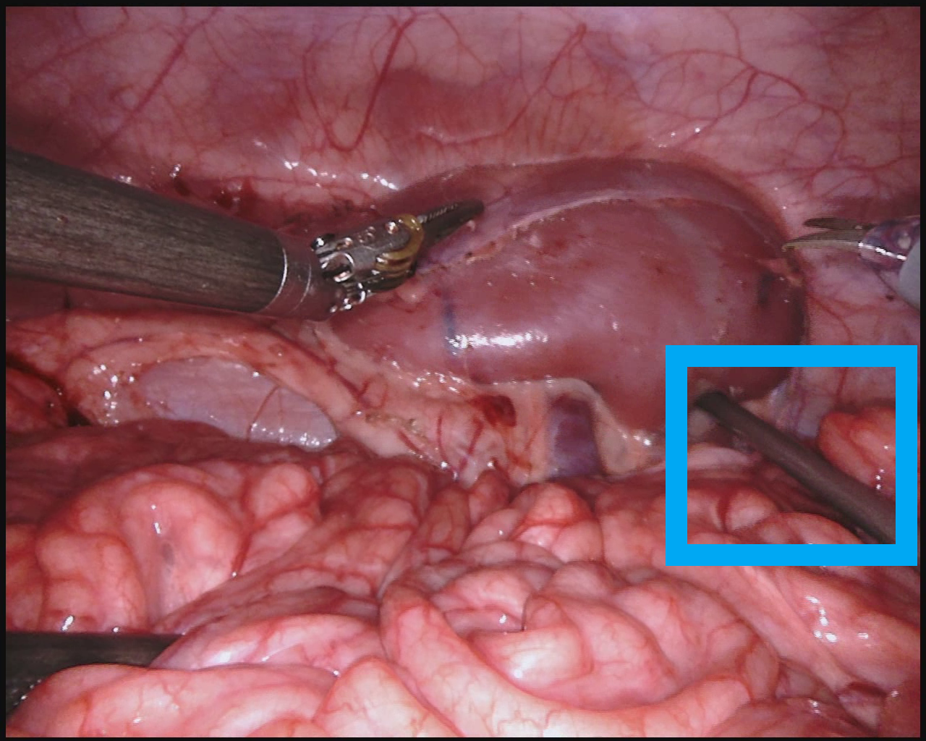
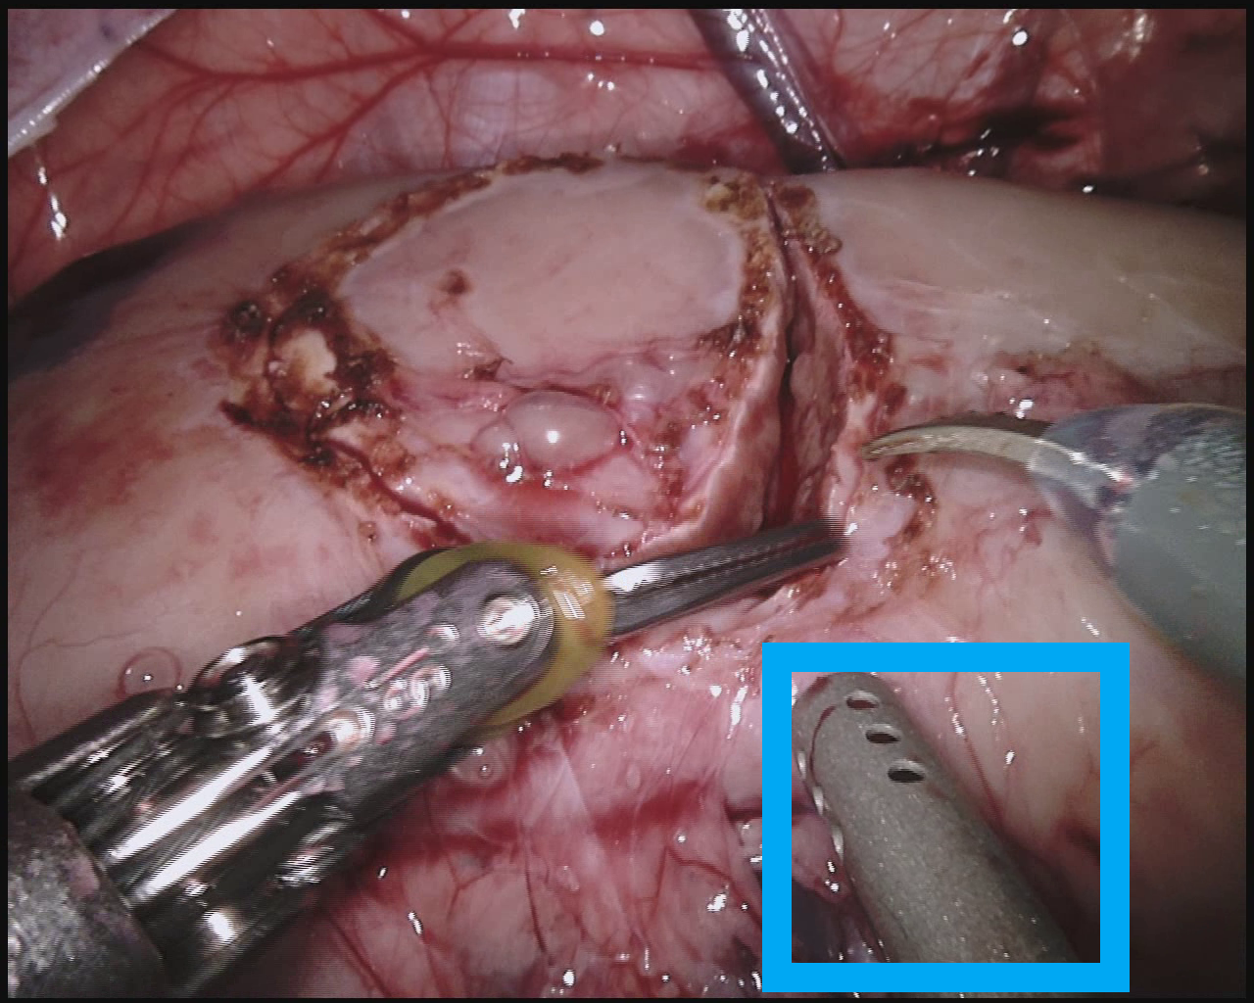
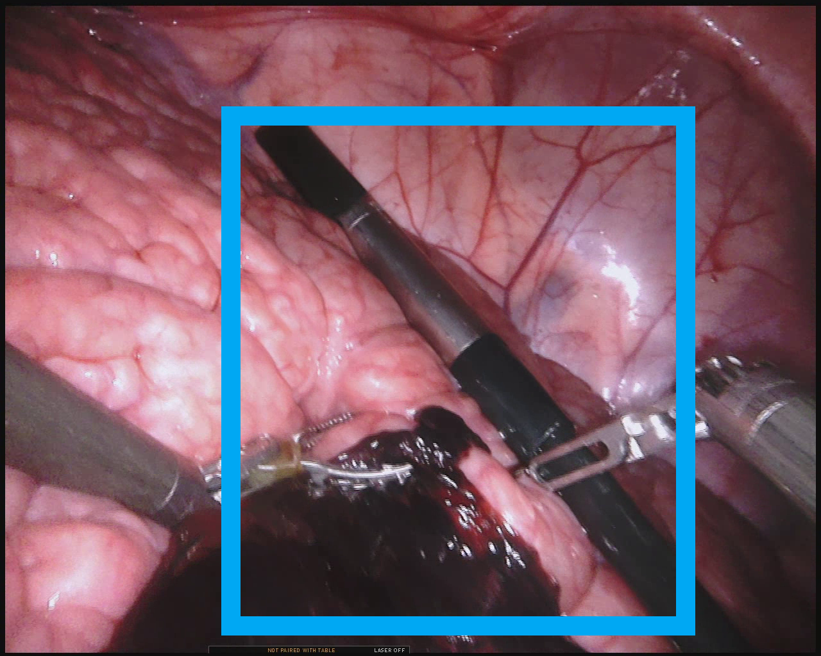
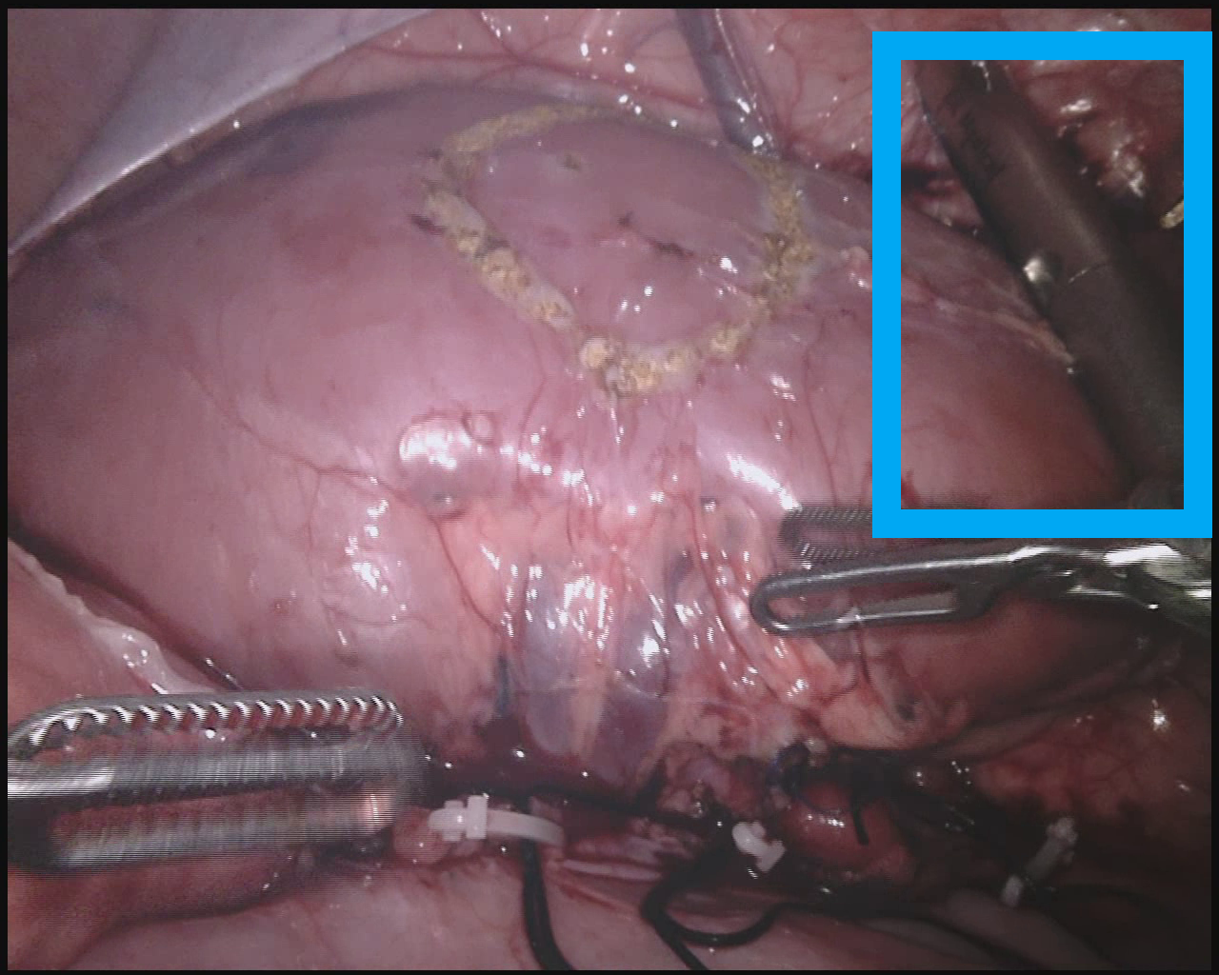
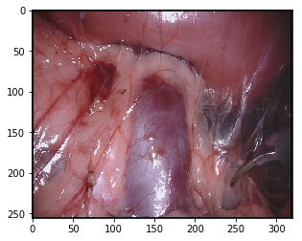
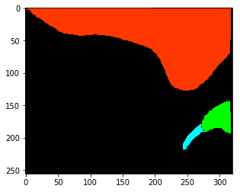
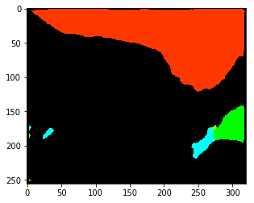
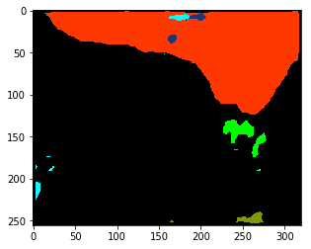
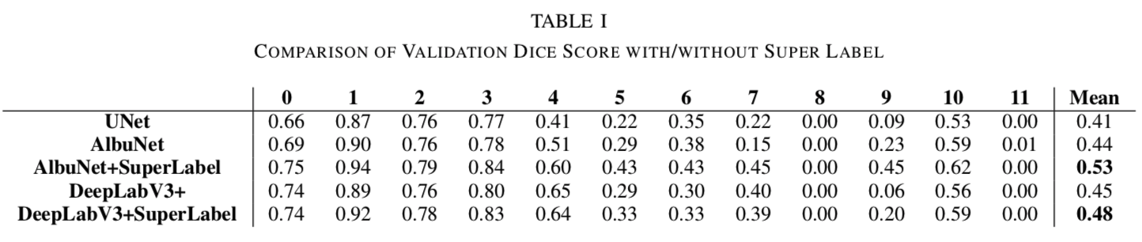
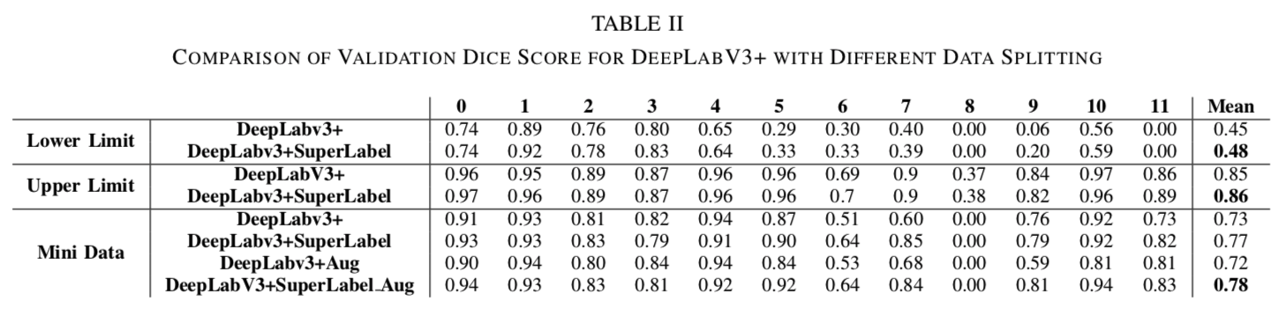
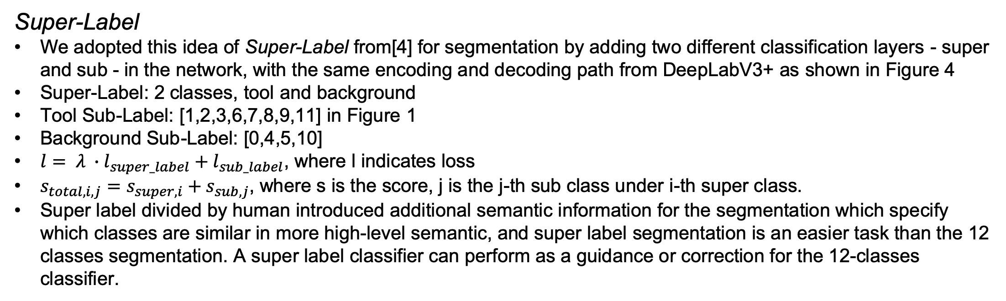
Semantics Segmentation for Surgical Scenes
Hao Ding, Mingyi Zheng, Zhaoshuo Li Mentor: Yeping Wang
Introduction
Data and Augmentation
Robot-assisted surgeries are currently completely human teleoperated, given a prominent example of the da Vinci surgical robot developed by the Intuitive Surgical Inc. One future direction of surgical assisted surgeries is to increase the level of autonomy, which requires certain level of scene understanding.
We proposed an architecture design named Super- Label which can improved the segmentation result, and a data splitting method named Mini-Data which encourages the diversity of data. We have demonstrated the efficacy of our approaches with a mean dice score of 0.78 on only 20% of the total data.
MICCAI EndoVis2018:
13 sequences of video sampled at 5 Hz, each sequence containing 150 frames, totaling 1950 images
Surgical setting:
Partial nephrectomy in pig test
Classes: 12 categories of objects shown in Figure 1
Spatial Augmentation:
Horizontal flip
Affine transformation with 0.1 scale limit, 0.1 shift limit and 30 degrees rotation limit
Cutout
Image Augmentation
Random brightness, Random Gamma, Random Contrast, Random HSV
Motion blur
Architecture
U-Net [1]: an encoder-decoder design, with the idea being low dimensionality latent representation can be blown up to high-level classification result. A simplified U-Net is implemented for our project, which has 3x max-pooling layers and 3x up-conv layers.
AlbuNet34 [2]: similar to U-Net, except that after down-sampling, the fully-connected layers in the bottleneck part of the network is replaced with a pre-trained ResNet34 before the fully-connected layers.
DeepLabV3+ [3]: use a tunable dilated convolution called ASPP and skip-connections to concatenate encoding and decoding features. ResNet101 is used in our project as backbone.
Figure 1: Object classes in EndoVis 2018
Methodology
Figure 2: U-Net
Figure 3: AlbuNet
Figure 4: DeepLabV3+
Experiment and Result
Experiment Setup
Hyper Parameters: as shown in Figure 5
Data Processing:
Lower Limit: Split the data based on video sequences. Sequences 4,5,11 are split for validation and the rest of sequences are used for training.
Upper Limit: Split the data by leaving 20% video sequences out for validation and extract the rest 80% frame from each video sequence, serving as the golden standard since it overfit well on the training data.
Mini Data: uniformly sampled 20% of frames from each video sequence
Batch size | 10
Epoch with augmentation | 60
Epoch without augmentation | 30
Learning rate | 0.001
Optimizer | Adam
Weight Decay | 0.0005
Scheduler LR decay per epoch | 0.95
Super class weight | 0.5
Figure 4: Super-Label Network+
Super-Label
We adopted this idea of Super-Label from[4] for segmentation by adding two different classification layers - super and sub - in the network, with the same encoding and decoding path from DeepLabV3+ as shown in Figure 4
Super-Label: 2 classes, tool and background
Tool Sub-Label: [1,2,3,6,7,8,9,11] in Figure 1
Background Sub-Label: [0,4,5,10]
$l= λ ∙l_{super_label}+l_{sub_label}$, where l indicates loss
$s_{total,i,j}=s_{super,i}+s_{sub,j}$, where s is the score, j is the j-th sub class under i-th super class.
Super label divided by human introduced additional semantic information for the segmentation which specify which classes are similar in more high-level semantic, and super label segmentation is an easier task than the 12 classes segmentation. A super label classifier can perform as a guidance or correction for the 12-classes classifier.
Figure 5: Hyperparameters
Super-Label Result
The dice score of AlbuNet and DeepLabV3+ can be increased by 0.09 and 0.03 with Super- Label in TABLE I
In the extreme case, the Super-Label approach increases the dice score by 0.24 for an unseen validation image during our experiment. The result shown in Figure 7.
AlbuNet also outperforms the DeepLabV3+ due to a shallower network, therefore less prone to overfitting
Mini-Data Result
With only limited 20% of the data, the Super-Label is able to segment the rest of the video sequence with dice score 0.78, which is only 0.09 less than upper limit shown in TABLE II.
In the Mini-Data test, the DeepLabV3+ with Super-Label outperforms DeepLabV3+ by 0.04 without augmentation and 0.06 with augmentation in TABLE II.
However, for small objects with only few pixels, such as the needle class (only 9 frames containing this classes, with a total of 4754 pixels), we only successfully segmented it with the ”upper limit” data splitting technique.
More data should be beneficial for learning this class, for which augmentation and increased dice loss weight could not help.
Mini-Data
Challenge to predict an object never seen due to the limited training data available (2235 image in total) and the distinct distribution of object visual appearances of different video sequences. Figure 6
Thus, we proposed to split data and validation by sampling only 20% of a given video sequence and generalizing the network to the rest of 80% in order to include more diversity with the same amount of annotated data.
(a)
(b)
(c)
(d)
Figure 6: Example images from training and validation set with objects of interest enclosed in blue rectangles. (a)(b) Training and validation images of the suction tool, (c)(d) Training and validation image of the ultrasound probe
Conclusion
(a)
(b)
(c)
(d)
In conclusion, we have proposed and evaluated two approaches for the challenges in surgical scene segmentation. The Super-Label can help the segmentation by learning the details of the small objects, while Mini-Data can encourage the learning process with fewer data.
In the future, it will be great to compare the performance of proposed approach with the 3D U-Net, by incorporating temporal information. Also, the network's performance against the full resolution images has not yet tested. If the test data used for the challenge can be made available, further evaluation can be done. Moreover, a few ideas that we came up with but didn't get sufficient time to implement such as using puzzle solving for pre-training and random cropping the original image.
Figure 7: Example outputs with and without Super-Label. (a)(b) Input and label images, (c) output from models with Super-Label (d) output from models without Super-Label.
References and Acknowledgements
[1] O. Ronneberger, P. Fischer, and T. Brox, “U-net: Convolutional net- works for biomedical image segmentation,” in International Confer- ence on Medical image computing and computer-assisted intervention. Springer, 2015, pp. 234–241.
[2] A. A. Shvets, V. I. Iglovikov, A. Rakhlin, and A. A. Kalinin, “An- giodysplasia detection and localization using deep convolutional neural networks,” in 2018 17th IEEE International Conference on Machine Learning and Applications (ICMLA). IEEE, 2018, pp. 612–617.
[3] L.-C.Chen,Y.Zhu,G.Papandreou,F.Schroff,andH.Adam,“Encoder- decoder with atrous separable convolution for semantic image segmen- tation,” in Proceedings of the European Conference on Computer Vision (ECCV), 2018, pp. 801–818.
[4] B. Singh, H. Li, A. Sharma, and L. S. Davis, “R-fcn-3000 at 30fps: Decoupling detection and classification,” in Proceedings of the IEEE Conference on Computer Vision and Pattern Recognition, 2018, pp. 1081–1090.

